Slide 1
June 21 and 22, 2022
Satellite Workshop
Block 1 – Industrial Use Cases and Network Requirements
Prof. Dr. Dirk Kutscher – University of Applied Sciences Emden/Leer

Slide 2
Middleware for Automated use of Edge Resources In Campus networks
www.maveric-project.org

Slide 3
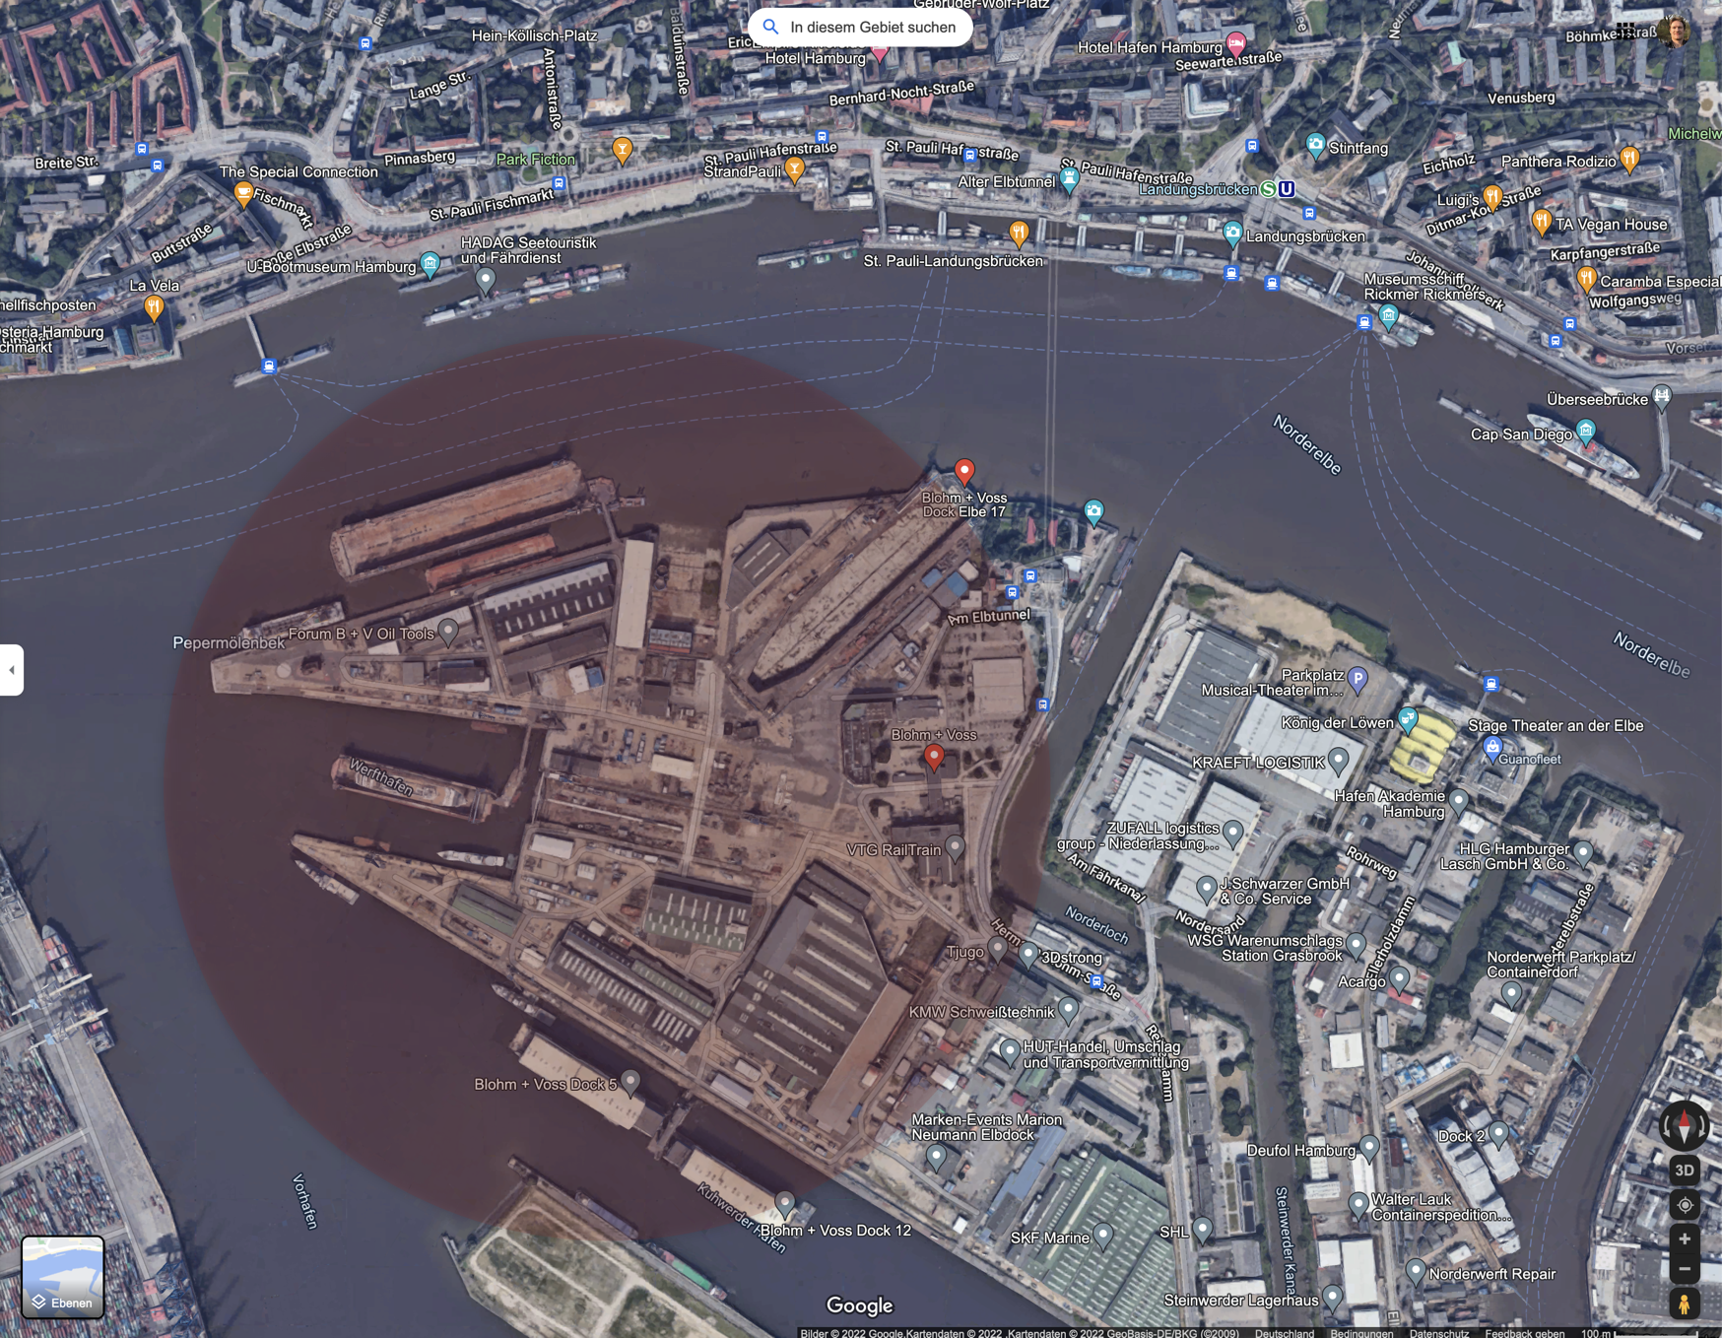
Objectives
Middleware for Automated use of Edge Resources In Campus networks
Challenges
Difficult radio environments
Unstable backhaul, Pop-Up networks
Adequate robust application support
Ubiquitous access to online resources (manuals etc.)
Application proxies (edge computing)
Automatic distribution of application proxies and state synchronization after disconnections
Support for heterogeneous deployments
5G (ORAN, BBU+RRU), LTE, WLAN
Assess technical and economic case for ORAN
Security
Zero-Trust needed for radio network
Secure integration into enterprise networks and AAA infrastructure

Slide 4
Use Cases
Overview
Ubiquitous coverage for “always-on” access
Whole campus
General-purpose networking
Ship in construction (in dock, at pier)
In-ship connectivity
Difficult radio conditions
Ship in test operation
Pop-up Network
Challenged or non-existant backhaul
Potentially: multi-site operation with roaming (later)

Slide 5
MAVERIC Use Case One Pager
1. Ubiquitous Coverage for ”Always-On”
Brief Use Case Description
Innovation
Market Relevance
Large campus with challenging building structures (docks etc.)
Mix of different UE equipement, including non-5G
5G as enterprise core network (no ubiquitous fixed infrastructure)
Outdoor and indoor radio units
LTE and 5G
WiFi CPE
General-purpose networking but support for more demanding applications as well (low latency, high bandwidth)
Heterogeneous network (5G, LTE, ORAN, non-ORAN, non-3GPP)
Network slicing and service differentiation in challenged networks
Production campuses with challenging network conditions
For big outdoor areas
Flexible connectivity – network anywhere anyhow
Typical enterprise environments with heterogeneous legacy networks and UEs
Use Case KPIs (Application Viewpoint)
Implementation Partners and Locations
Coverage and throughput-related
Details (number of users, throughput KPIs etc)
Reliability of the network – meantime between failure
Latency
Throughput
University campuses as developer networks
NVL campus in Hamburg (Blohm&Voss shipyard)

Slide 6
MAVERIC Use Case One Pager
2. Ship in Construction
Brief Use Case Description
Innovation
Market Relevance
Ship in dock or at pier – want to provide connectivity on and within the ship
Challenged radio environment
Possibly challenged backhaul connectivity
Dedicated antennas (e.g., coax cables)
Potential dedicated radio control
Autonomous networks
In-Network Computing – distributing application logic depending on network performance and availability
Applicable to other challenged environments as well
Indoor production environments, mines etc.
Use Case KPIs (Application Viewpoint)
Implementation Partners and Locations
Coverage and throughput-related
Details (number of users, throughput KPIs etc.))
Application-level „Quality of Experience“
NVL campus in Hamburg (Blohm&Voss shipyard)

Slide 7
MAVERIC Use Case One Pager
3. Ship in Test Operation
Brief Use Case Description
Innovation
Market Relevance
Ship on test trip (Elbe/Weser, North Sea etc.)
Objective: provide adequate connectivity (ideally: similar to shipyard network from applications‘ perspective)
Backhaul access to enterprise network may be limited or non-existant
Limited satellite or public mobile network coverage could be used
Pop-Up Networks: Self-contained networks with multiple backhaul connectivity options
Support for challenged backhaul
Smart, automated application provisioning on local pop-up network (in-network computing)
High relevance expected: concept can be applied to different types of networks, with different levels of performance constraints
Use Case KPIs (Application Viewpoint)
Implementation Partners and Locations
Per-application KPIs (TBD)
For example, we will define a set of applications that are supposed to work and then re-factor them with respect to application modules, server components etc. that can be provisioned on the pop-up network platform.
Examples
Document access
AR
What else?
NVL campus in Hamburg (Blohm&Voss shipyard)
Ship in production

Slide 8
MAVERIC Network Requirements
Network Aspects | Characteristics | Requirements of Use Case 1 | Requirements of Use Case 2 | Requirements of Use Case 3
5G Network Coverage | Long term / short term / nomadic indoor / outdoor, Easily extensible / modifyable | Ubiquitous, outdoor & indoor | Support for challenged radio environments | Challenged backhaul
5G Network QoS | Focus on low latency / high throughput / high device density focus on availability / reliability temporally/spatially adaptable / adaptive scalable device counts / device req. | High device density, availability | availability | Temporally/spatially adaptable, low latency, high throughput (without perfect backhaul)
5G Network Control | Automated operation self optimizing application controlled | Automated operation | Self-optimizing (radio) | Automated operation, application-controlled/adequate in-network computing
5G Network Monitoring | QoS monitoring network element monitoring usage traceability detailed health check on demand | QoS monitoring | Radio monitoring | Ideally: zero-monitoring
Other 5G Network Requirements |  | Zero-trust (heterogeneous RAN) | Zero-trust (heterogeneous RAN) | Seamless in-networking computing for challenged backhaul
Overarching Nw. Infrastructure | Integration with other LAN infrastructure integration with other WAN infrastructure | WiFi 6 integration

Slide 9
MAVERIC Use Cases Implementation Timeline
When will use cases be ready for testing in the envisaged Open RAN testbed ?
When is Open RAN testbed envisaged to be ready for use case testing ?
When will use cases be tested and evaluated in Open RAN testbed ?
When will use case demos be available ?
 | Use Case Development |  |  | Testbed | Evaluation | Demo
 | UC1 | UC2 | UC3
2022 Q2
2022 Q3 | X
2022 Q4 | X |  |  | X
2023 Q1 | X | X
2023 Q2 | X | X
2023 Q3 | X | X | X
2023 Q4 |  | X | X |  | X
2024 Q1 |  | X | X
2024 Q2 |  |  | X
2024 Q3 |  |  | X |  |  | X
2024 Q4
2025 Q1

Slide 10
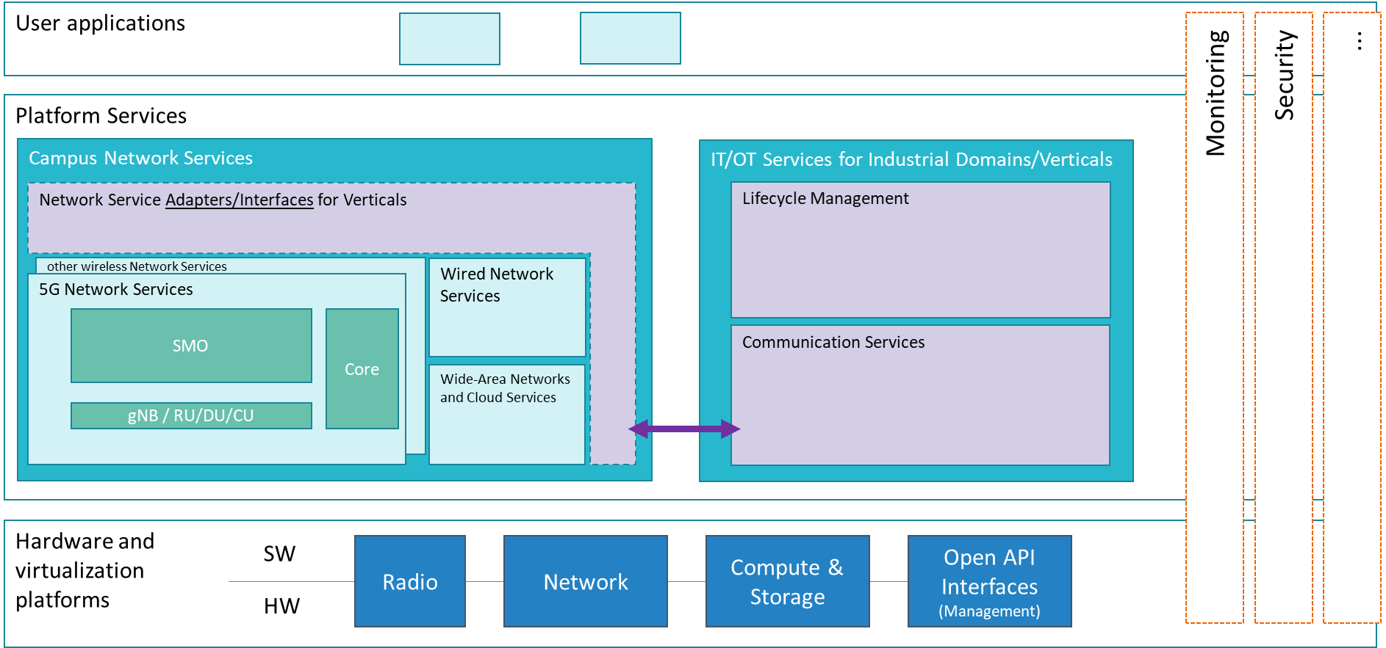
MAVERIC Architecture Fit (TBD)
Examples

